Slide 1
9-channel relay board
Presenter:
Guilliams Martijn
1EAIB

Slide 2
Content
What? Why?
Components
How?
Live demo
Reflection
2

Slide 3
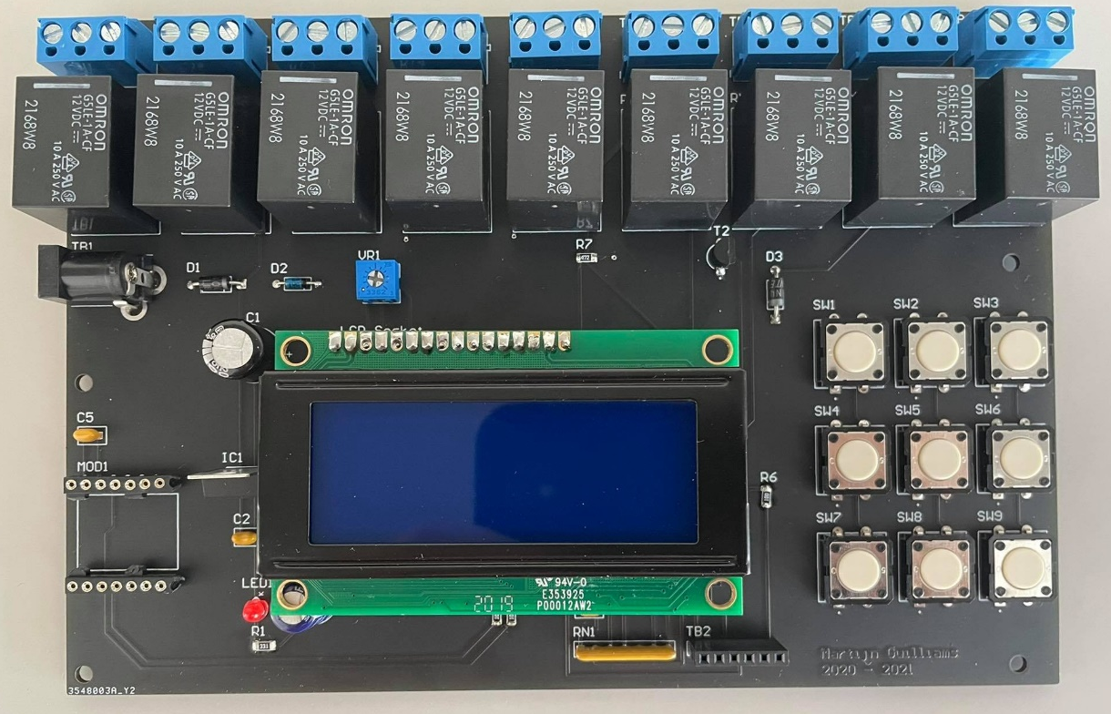
What? Why?
Turn relays on/off
Relays
3

Slide 4
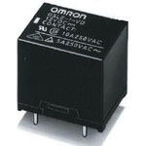
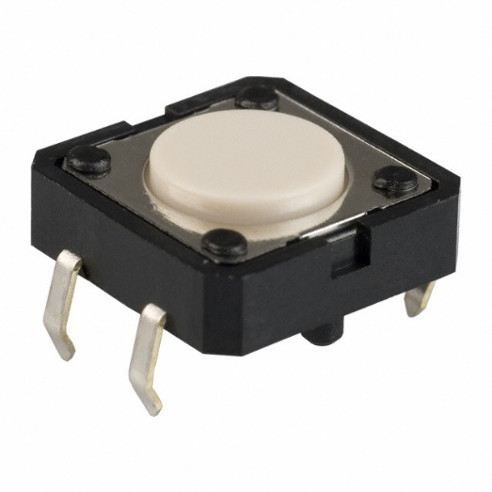
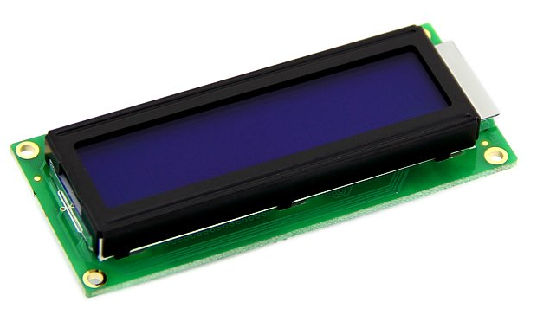
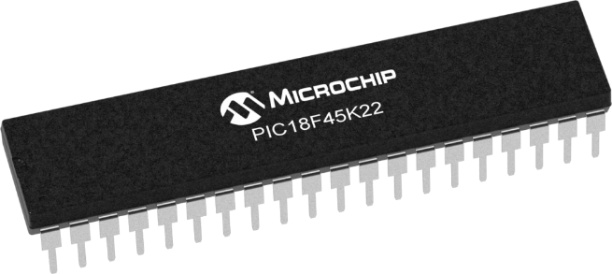
Components
Relays
Buttons
LCD
Microcontroller
4

Slide 5
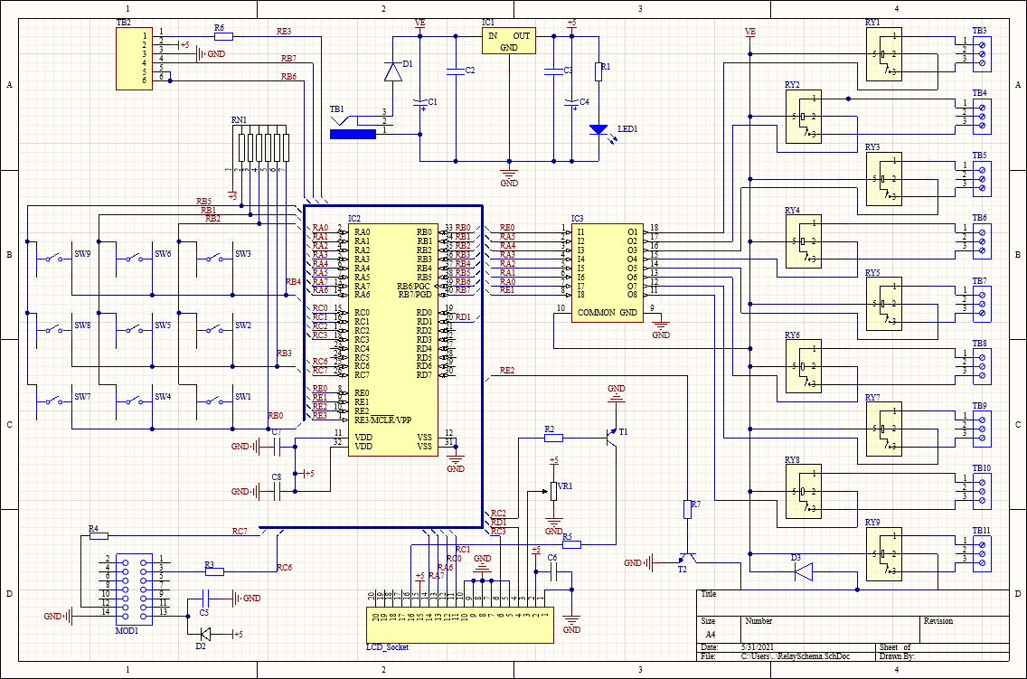
How?
12V is needed
IC1 (5V)
IC2 Microcontroller
5

Slide 6
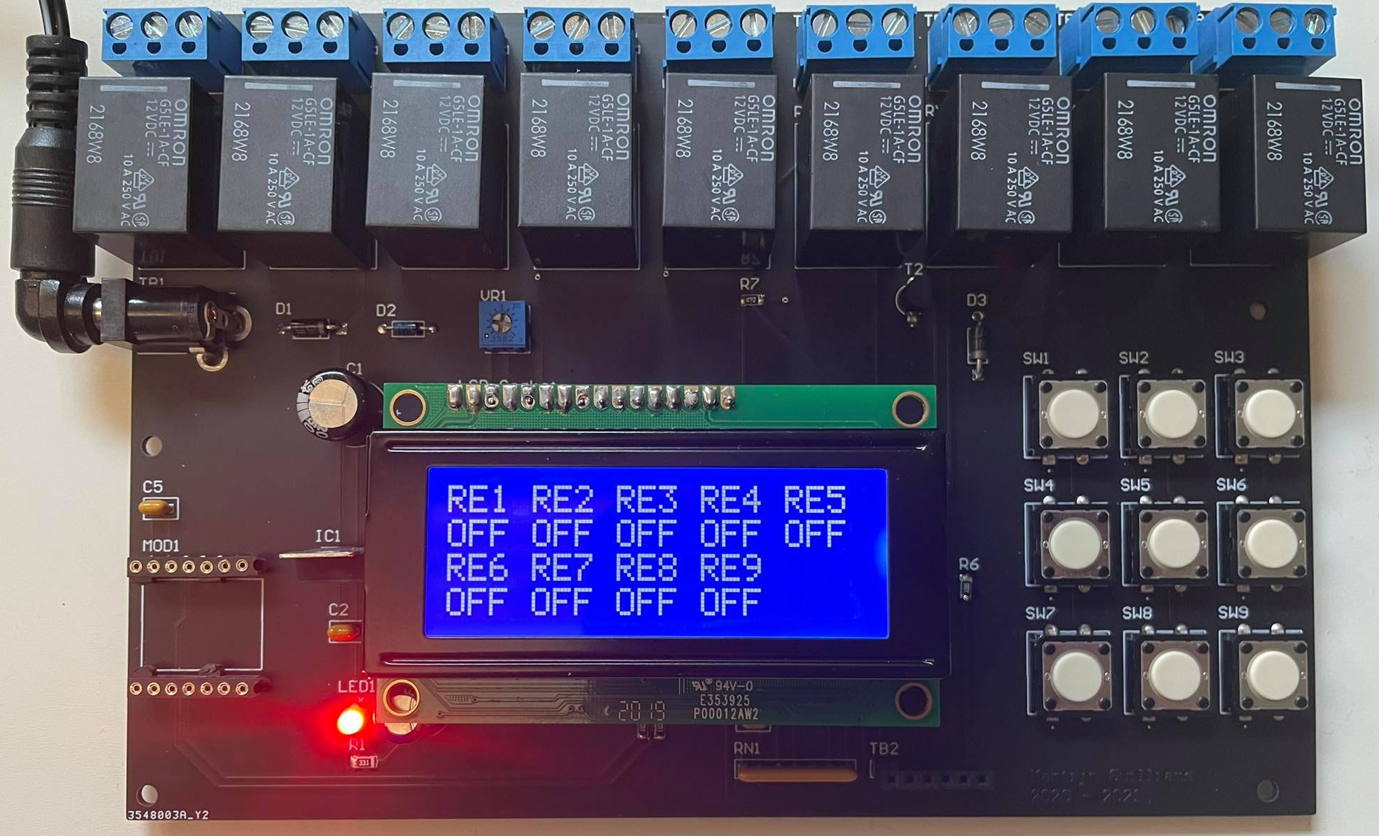
Live demo
6

Slide 7
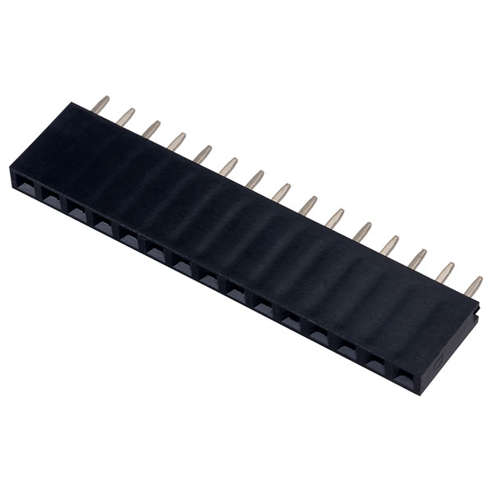
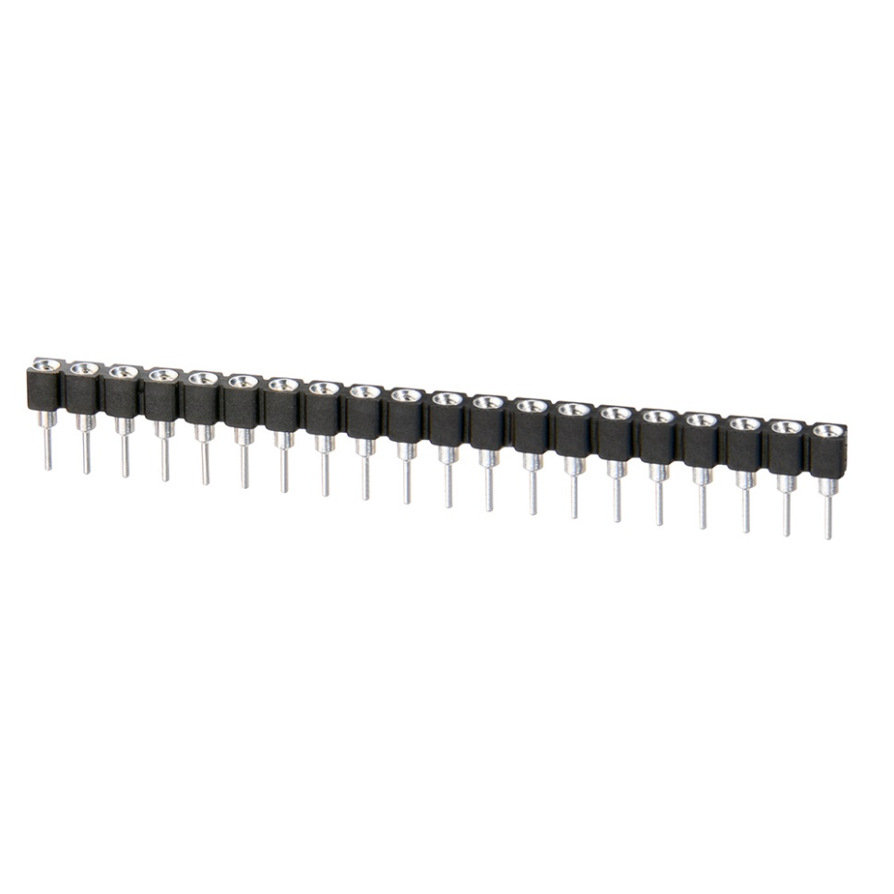
Reflection
Wrong socket
Case design
7

Slide 8
Questions?
8

